Slide 1
Protein and Amino Acid Catabolism and the Urea Cycle
Announcements:
Two student presentations today
Dave will be out of town tomorrow-Sunday, will respond to email
If you have submitted a news article, make sure ot put it in GradeCraft

Slide 2
Quiz Question #1
Which catabolic process is best suited to the digestion of large organelles?
Proteasomal Degradation
Collagenase Digestion
The Urea Cycle
Autophagy

Slide 3
Quiz Question #2
What is the function of the urea cycle?
Removal of carbon from glutamate
Conversion of CO2 into bicarbonate
Conversion of ammonia into urea
Production of urea for amination reactions

Slide 4
Quiz Question #3
Which of the following is a ketogenic amino acid
Alanine
Lysine
Glycine
Glutamate

Slide 5
Learning Objectives
Evaluate the signals that lead to protein degradation and how those signals activate proteolysis and autophagy.
Explain the circumstances by which amino acids and proteins would be degraded.
Describe the fates of the carbon skeletons when amino acids are catabolized.
Consider the importance of branched chain amino acids, and describe the regulation of branched-chain ketoacid dehydrogenase.
Explain the key role, and the mechanisms of regulation of Glutamate Dehydrogenase in amino acid catabolism.
Describe the role of the urea cycle and analyse how defects in the urea cycle could be detected and treated.

Slide 6
Two main mechanisms of protein breakdown
Proteolysis
Lysosome/Autophagy
Mediated by proteasome
Regulated by insulin inactivation of FOXO
Proteins marked by ubiquitinylation
Regulated by inactivation of mTORC1
Traffics proteins/organelles to lysosome for degradation
Notes:
2004 nobel prize
2016 nobel prize
mention targetted vs bulk degradation

Slide 7
Why Break Down Proteins into Amino Acids
Endocrine signals
Nutritional signals
Hormone | Effects on Protein Synthesis | Effects on Protein Degradation
Insulin | Promotes | Blocks
Glucocorticoids | Blocks | Promotes
Growth Hormone/IGF1 | Promotes | Blocks
Testosterone | Promotes | Blocks
Via mTORC1
Low energy
Low intracellular Leu, Lys, Arg
Why should protein catabolism be avoided?
Notes:
Slow down and mention mTORC1 is central to both of these. Processes don’t matter

Slide 8
The Amino Acid Pool

Slide 9
Which enzyme prevents glucose from being used when Alanine levels are high?
Alanine Aminotransferase
Fructose-1,6-bisphosphatase
Pyruvate Kinase
Pyruvate Carboxylase

Slide 10
Why would amino acids become glucose, rather than energy?
Complicated question
Regulation depends on which amino acid we mean
Some cannot become glucose, some have a complicated path
Are there other factors driving anaplerosis?
Are other amino acids available?

Slide 11
Components of Amino Acid Degradation
Fates of the Carbon Skeleton
Fates of the Amino Group
Notes:
talk about energy here

Slide 12
Most amino acids are degraded by aminotransferases
Substrates |  | Enzyme | Products
Pyruvate | Glutamate | ALT | Alanine | α-Ketoglutarate
Oxaloacetate | Glutamate | AST | Aspartate | α-Ketoglutarate

Slide 13
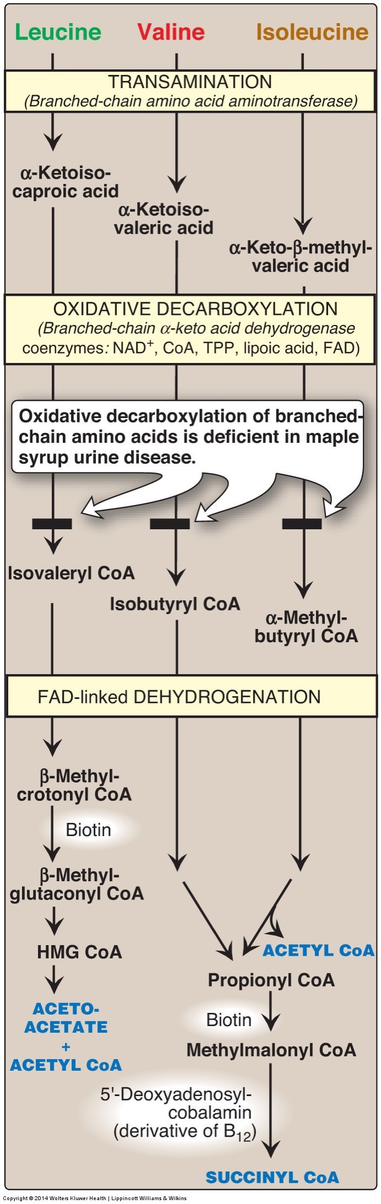
BCAA’s start with a transamination
Substrates |  | Enzyme | Products
Alanine | α-Ketoglutarate | ALT | Pyruvate | Glutatmate
Aspartate | α-Ketoglutarate | AST | Oxaloacetate | Glutatmate
Leucine | α-Ketoglutarate | BCAT | α-Ketoisocaproate | Glutatmate
Valine | α-Ketoglutarate | BCAT | α-Ketoisovalerate | Glutatmate
Isoleucine | α-Ketoglutarate | BCAT | α-Ketomethylvalerate | Glutatmate

Slide 14
Why are BCAA’s Important in Nutrition?
These three amino acids are a major constituent of total protein
~20% of all amino acids in protein
~35% of all indispensable amino acids in protein
There is a low amount of free BCAA’s in tissue
Of the 3-5g/kg of free AA in tissue, only ~0.1g are BCAA
Defects can lead to Maple syrup urine disease
Notes:
Of the 3-5 g/kg in tissue only ~0.1g are

Slide 15
More BCAA Catabolism
Leu/Val/Ile all use same BCAT/BCKDH steps
Next Step is Controlled by BCKDH
BCKDH is inhibited by protein phosphorylation
Activated by ketoisocaproic acid

Slide 16
Maple Syrup Urine Disease
Presented by Eliza Jarman

Slide 17
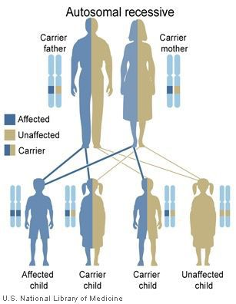
What is MSUD?
Also known as BCKD Deficiency
Inherited disease – autosomal recessive pattern
Affects 1 in 185,000 infants worldwide
Name derived from the sweet odor of affected infants’ urine
Body is unable to process certain amino acids
Characterized by poor feeding, lethargy, vomiting, abnormal movements, and delayed development
Untreated MSUD can lead to seizures, coma, or death
Notes:
-BCKD deficiency = branched-chain ketoacid dehydrogenase deficiency or branched-chain ketoaciduria
-Autosomal recessive inheritance pattern, meaning both copies of the gene in each cell have to be mutated
-Frequency much higher in the Mennonite populations in the United States at 1 in 380 newborns

Slide 18
MSUD Mechanism
Mutations in BCKDHA, BCKDHB, and DBT genes can reduce or eliminate functioning of the branched-chain ketoacid dehydrogenase complex
BCKD needed to break down leucine, isoleucine, and valine
Buildup of BCAAs and ketoacids in the body
Toxicity of AAs is restricted to leucine
One of the organic acids that accumulates along with BCAAs is responsible for the smell
Notes:
-These genes provide instructions for making proteins that work together as a complex
-High plasma levels of these branched chain amino acids are toxic to the brain and other organs
-Accumulation of the ketoacids results in metabolic acidosis
-Ketoacids = acids that contain a ketone group

Slide 19
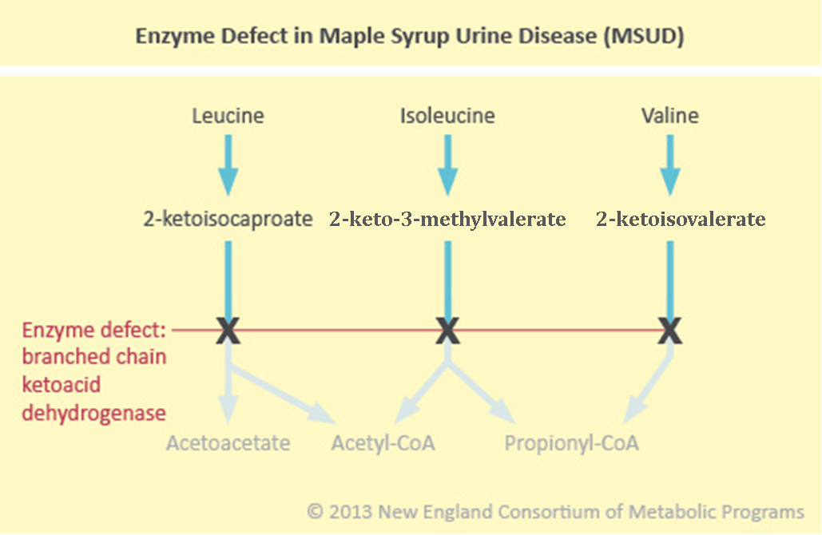
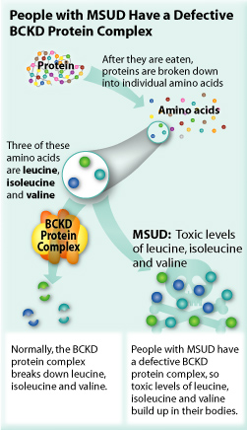
MSUD Mechanism

Slide 20
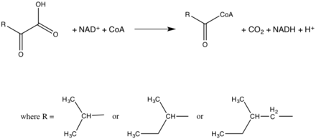
Branched-Chain Ketoacid Dehydrogenase Complex
Found on the mitochondrial inner membrane
Catalyzes the oxidative decarboxylation of branched, short-chain alpha-ketoacids
Coenzymes:
Thiamine pyrophosphate
FAD
NAD+
Lipoate
Coenzyme A
Notes:
FAD = Flavin adenine dinucleotide
NAD+ = Nicotinamide adenine dinucleotide
Pictured: this is the overall reaction catalyzed by the branched-chain alpha-ketoacid dehydrogenase complex

Slide 21
Types of MSUD
Classic MSUD:
Plasma concentrations of the BCAAs begin to rise within a few hours of birth
Symptoms emerge within 24-48 hours of life
Non-specific symptoms: Poor breastfeeding/bottle feeding, lethargy, irritability, distinctive odor of sweat, urine, and earwax
Focal neurological symptoms: Hypertonia, spasticity, convulsions, coma
Behavioral issues: ADHD, impulsivity, anxiety, depression
Additional complications: Loss of bone mass, pancreatitis, intracranial hypertension
Intermediate MSUD:
Greater levels of residual enzyme activity
Majority of children diagnosed between 5 months and 7 years
Seizures, neurological impairment, developmental delays
Notes:
-Classic MSUD = most common type and most severe form of MSUD characterized by little to no enzyme activity
-General loss of bone mass may predispose individuals to fractures, osteoporosis
-Pancreatitis = inflammation of the pancreas
-Intracranial hypertension = leads to increased blood pressure in the skull causes painful headaches associated with nausea and vomiting
-Intermediate MSUD patients are susceptible to the same neurologic conditions and extreme symptoms as those with classic MSUD
-Not a definite distinction between the two, so disease management principles are the same for both

Slide 22
Types of MSUD
Intermittent MSUD:
Normal growth and intellectual development
Can tolerate normal levels of AA in diet
Symptoms appear when child experiences stress, does not eat, or develops an infection
Symptoms: lethargy, maple syrup odor, ataxia
Metabolic crises can result in seizures, coma, brain damage
Thiamine-Responsive MSUD:
Responds to treatment with thiamine (vitamin B1)
Thiamine boosts residual enzyme activity
Symptomology resembles intermediate MSUD
Notes:
-Ataxia = the loss of full control of bodily movements

Slide 23
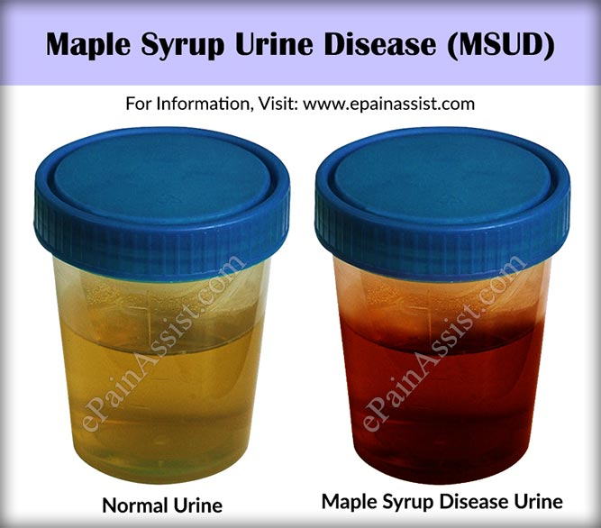
Diagnosis
Early diagnosis is key!!
Newborn screening for MSUD
Mild/intermittent forms may show normal blood amino acids
Tests:
Urine analysis
Blood analysis
DNA testing
Prenatal diagnosis
Notes:
-Screening via tandem mass spectrometry
-Mild and intermittent forms may show normal plasma amino acid levels during newborn screening and can be missed
-Urine analyses performed to detect high levels of keto acids or ketoaciduria
-Blood analyses performed to detect abnormally high levels of amino acids

Slide 24
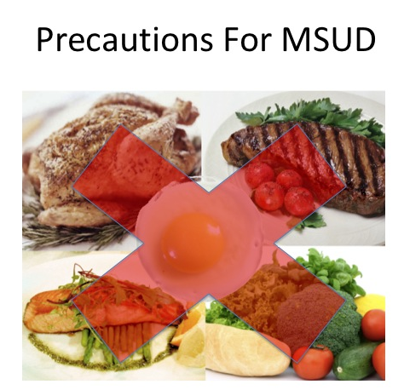
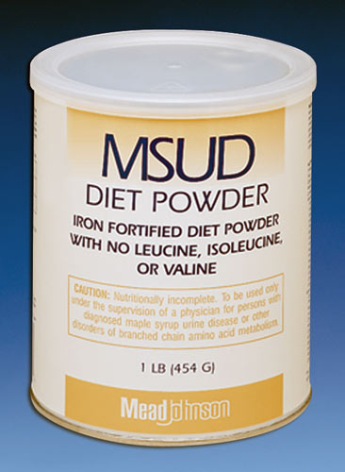
Treatment
Protein-restrictive diet
Synthetic formulas
BCAA-free medical foods
BCAAs added to the diet separately in small amounts for monitoring
Thiamine therapy
Even with treatment, patients remain at high risk for developing episodes of acute illness (metabolic crises)
Triggered by infection, injury, fasting, or psychological stress
Spike in amino acid levels
Requires immediate medical intervention
Reduce and reverse protein catabolism
Liver transplantation
Notes:
-Their diet must limit the amount of BCAAs they take in
-Protein restriction must occur as soon as possible after birth
-Synthetic formulas are available that provide all the nutrients necessary for proper growth and development (but lack leucine, isoleucine, and valine)
-Restrict diet to make sure there are no BCAAs, make sure they are getting enough calories, find proteins that don’t contain BCAAs so that they can still obtain other essential amino acids, and then supplement small amounts of BCAAs for proper growth and protein synthesis
-Trial of thiamine therapy to determine whether their MSUD is thiamine-responsive
-Never treated solely with thiamine!!
-These episodes of acute illness require immediate medical intervention
-Various techniques have been used to reduce plasma leucine levels, including dialysis or hemofiltration (process in which plasma is removed from the body and passed through a filter before returned to the blood)
-Goal is to reduce and reverse protein catabolism—this means any method to increase calories and reduce protein catabolism may be helpful
-This can include a high glucose intake with intravenous glucose if necessary or glucose-insulin drips since insulin is known to enhance endogenous protein synthesis
-In extreme cases, liver transplantation has been used to treat individuals with classic MSUD—the new liver supplies enough of the enzymes needed to breakdown the BCAAs that accumulate in MSUD

Slide 25
References
Ekvall, S., & Ekvall, V. K. (2017). Pediatric and adult nutrition in standard, chronic diseases, developmental disabilities, and hereditary metabolic disorders: prevention, assessment, and treatment (2nd ed.). New York, NY: Oxford University Press.
NIH. (2017). Maple Syrup Urine Disease – Genetics Home Reference. Retrieved October 24, 2017 from https://ghr.nlm.nih.gov/condition/maple-syrup-urine-disease#
National Organization for Rare Disorders (2017). Maple Syrup Urine Disease. Retrieved October 24, 2017 from https://rarediseases.org/rare-diseases/maple-syrup-urine-disease/
Strauss, K. A., Puffenberger, E. G., & Morton, D. H. (2006). Maple Syrup Urine Disease. Gene Reviews. Doi:10.3897/bdj.4.e7720.figure2f

Slide 26
Regulation of Branched Chain Ketoacid Dehydrogenase
A buildup of branched ketocacids (mainly α-Ketoisocaproate)
Inactivation of BCKDH kinase
Activation of BCKDH
More breakdown of branched ketoacids

Slide 27
The rest of BCAA metabolism has several steps

Slide 28
Which amino acid(s) are exclusively ketogenic?
Leucine
Isoleucine, Valine
Valine
All of the above
Notes:
So what are the possible fates of Acetyl CoA

Slide 29
Nitrogen rich amino acids
Glutamine and Asparagine have 2 amide groups

Slide 30
Glutaminase Breaks Down Glutamine into Glutamate, releasing Ammonia
+ADP
Masola B, Ngubane NP. The activity of phosphate-dependent glutaminase from the rat small intestine is modulated by ADP and is dependent on integrity of mitochondria. Arch Biochem Biophys 2010; 504:197–203.

Slide 31
Glutamine As An Energy Source
Glutamine can be used for energy
Enters TCA Cycle
Can be used for energy
Can be Anaplerotic or used for building other macronutrients
Some cancers rely on glutamine metabolism
Active area of drug development

Slide 32
Back to the transaminases…
Substrates |  | Enzyme | Products
Alanine | α-Ketoglutarate | ALT | Pyruvate | Glutamate
Aspartate | α-Ketoglutarate | AST | Oxaloacetate | Glutamate
Leucine | α-Ketoglutarate | BCAT | α-Ketoisocaproate | Glutamate
Valine | α-Ketoglutarate | BCAT | α-Ketoisovalerate | Glutamate
Isoleucine | α-Ketoglutarate | BCAT | α-Ketomethylvalerate | Glutamate
Tyrosine | α-Ketoglutarate | TAT | 4-hydroxyphenylpyruvate | Glutamate
Tryptophan | α-Ketoglutarate | TTA | (indol-3-yl)pyruvate | Glutamate
Methionine | α-Ketoglutarate | MAT | 2-oxo-4-methylthiobutanoate | Glutamate
Cysteine | α-Ketoglutarate | CT | Sulfinylpyruvate | Glutamate

Slide 33
Many Degradation Paths Lead Through Glutamate
Transaminases
Alanine (also makes pyruvate)
Aspartate (also makes oxaloacetate)
Asparagine (via Aspartate)
Leucine, Valine, Isoleucine (also makes branched ketoacids)
Tyrosine, Tryptophan, Methionine, Cysteine
Phenylalanine (via Tyrosine)
Arginine, Histidine, Glutamine and Proline (become glutamate)
Lysine makes glutamate in a dehydrogenase reaction
All but glycine, serine and threonine and lysine use transaminases
Threonine -> Glycine -> CO2/NH3
Serine -> Glycine -> CO2/NH3

Slide 34
Glutaric Acidemia
Noura El Habbal

Slide 35
GA-I
Also known as
Glutaryl-CoA dehydrogenase deficiency
Dicarboxylic aminoaciduria
Glutarate-aspartate transport defect
Glutaric aciduria type I

Slide 36
What is it?
Autosomal recessive disease
Inborn error of metabolism
Considered an organic acid disorder
Affects 1/40000 babies in the US
Occurs when enzyme “Glutaryl-CoA Dehydrogenase” is missing or not working properly

Slide 37
What does GCDH do?
GCDH (Glutaryl-CoA Dehydrogenase) is an enzyme encoded by the GCDH gene on chromosome 19
Exists in the mitochondrial matrix
It catalyzes the oxidative decarboxylation of Glutaryl-CoA to Crotonyl-CoA and carbon dioxide in the degradative pathway of Lysine, Hydroxylysine and Tryptophan
What happens with GA-I?

Slide 38
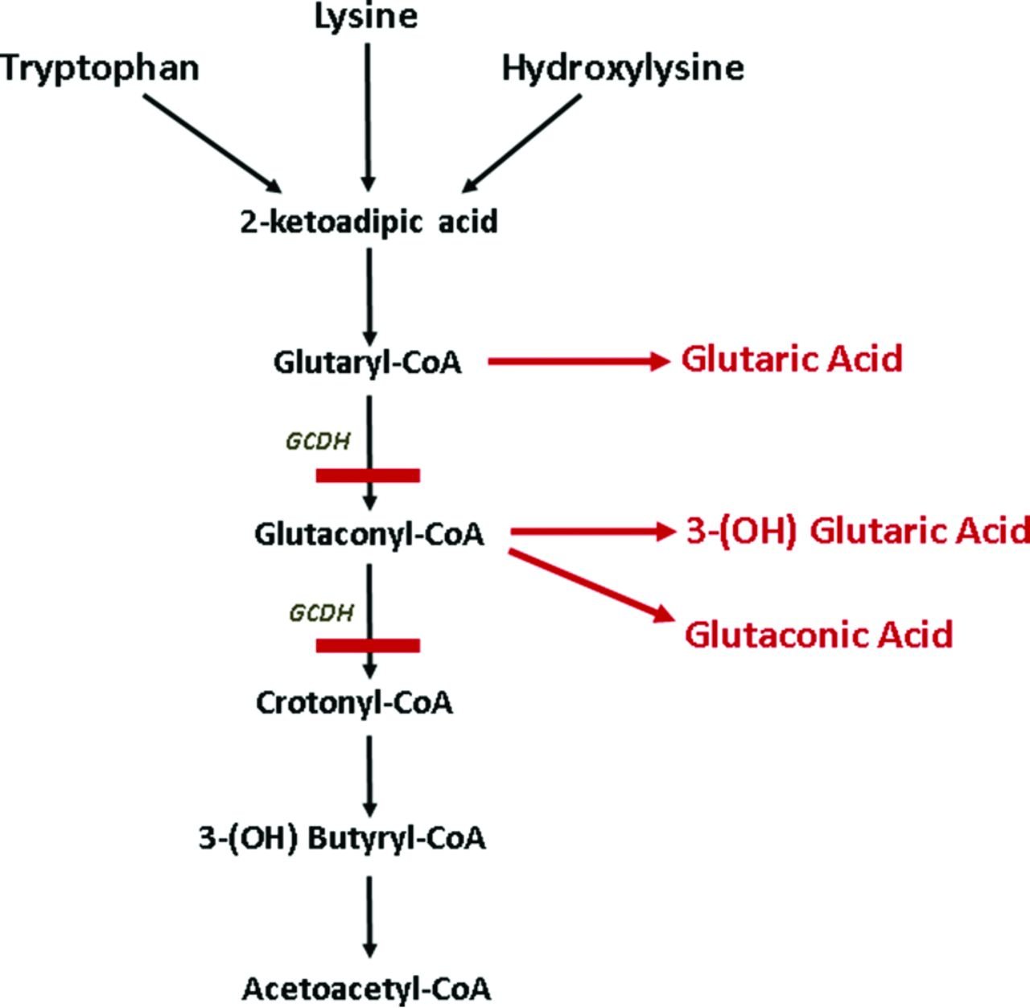
Lysine
EAA
Plays a role in building muscle protein, injury recovery, production of hormones, enzymes and antibodies
Found in high protein foods: eggs, red meats, soy, legumes, dairy products…
Hydroxylysine is the hydroxylated derivative of Lysine. It is a major component of collagen.
Tryptophan
EAA
Plays a role in neurotransmitter and hormone production, growth, and building muscle protein
Found in chocolate, dried dates, dairy products, red and white meats, almonds…

Slide 39
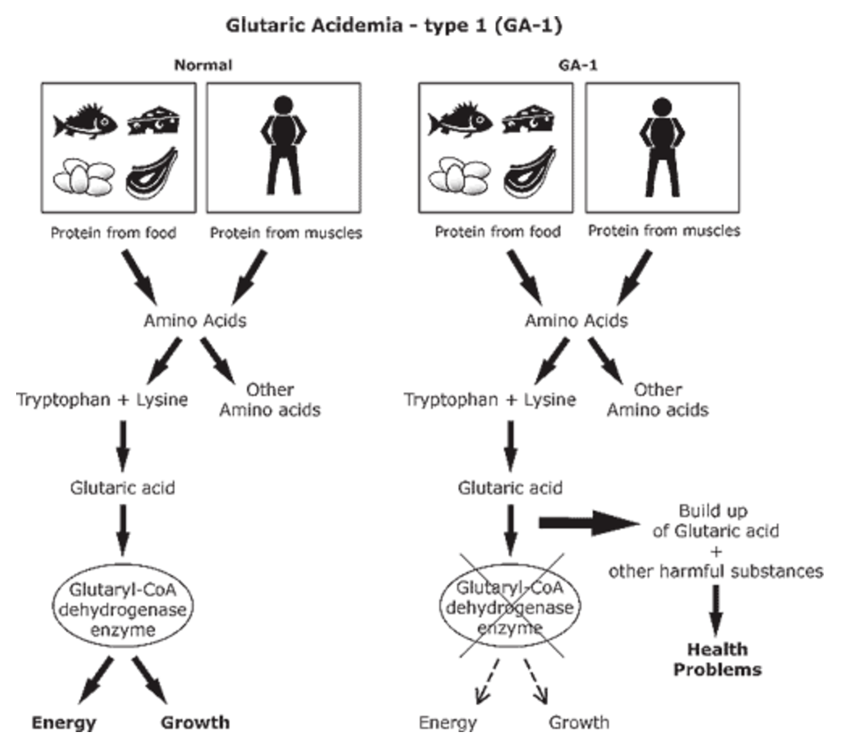
GCDH deficiency results in increased formation and excretion of glutaric acid (GA), 3-hydroxyglutaric acid (3-OH-GA), glutaconic acid and glutarylcarnitine (neurotoxins) that damage the brain and other organs
Secondary carnitine depletion is due to increased formation and urinary excretion of glutarylcarnitine.
GCDH deficiency, leads to neuronal damage, and mitochondrial dysfunction!

Slide 40
Signs and Symptoms
At birth, some babies do not show any symptoms, but they tend to have a larger than average head (macrocephaly). A baby with GA-1 who has not been treated will start to show signs between 4 months and 2 years of age.
Signs include: Poor appetite, tiredness, irritability, twitches, weak muscle tone (hypotonia), delayed growth, rigid muscles (spasticity), excessive sweating. Signs can be triggered by illnesses and infections
Metabolic crisis can occur. This is a serious health condition caused by the build-up of toxic substances in the blood. Symptoms of a metabolic crisis are poor appetite, nausea, vomiting, diarrhea, extreme sleepiness, irritable mood and behavior changes.
The severity of GA-1 varies highly for each individual

Slide 41
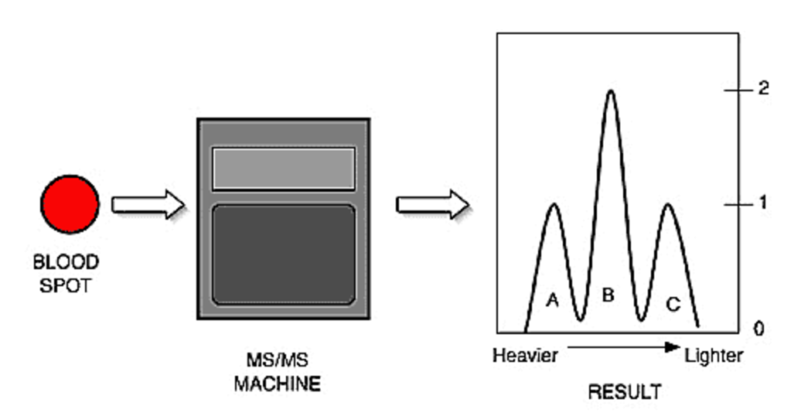
Screening
Amniotic fluid metabolite detection by mass spectrometry and gene mutation analysis (prenatal- looks at glutaric acid concentrations and genetic abnormalities)
Expanded newborn screening using tandem mass spectrometry (24-72 h after birth- uses few blood drop to test for over 30 disorders- if organic acids elevated → +ve)

Slide 42
Screening Cont’d and Diagnosis
Urine organic acid analysis (diagnostic with increased 3-hydroxyglutaric acid with or without increased glutaric acid)
Brain imaging can show early brain atrophy
What do you think are possible treatments?

Slide 43
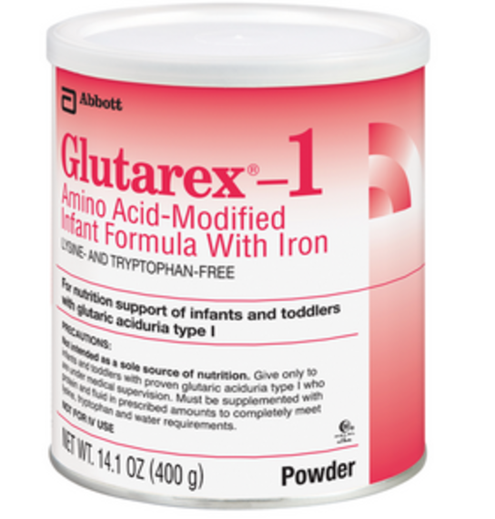
Treatment
Recommended therapeutic interventions aim to reduce lysine and tryptophan oxidation and to enhance physiologic detoxification of glutaryl-CoA via formation of glutarylcarnitine (carnitine supplementation).
Foods to be avoided or strictly limited include dairy products, meat (red and white), eggs, dried beans and legumes, nuts and peanut butter → evidence that low lysine diet reduces the accumulation of putatively neurotoxic GA and 3-OH-GA in the brain
Lysine and Tryptophan-free formula available for infants, toddlers and children. Breastfeeding is still encouraged but milk quantities are accurately measured!

Slide 44
Treatment Cont’d
Carnitine oral supplementation. Carnitine supplementation to remove glutaric acid. Carnitine supplementation increases the brain, liver and plasma concentrations of free carnitine thus allowing for enhanced detoxification
Riboflavin is usually recommended due to its benefits on motor neuron function during the maintenance phase, but there is no data to support its benefits in GA-I patients

Slide 45
Glucose and Arginine Treatments?
Glucose
Found to be helpful as it provides an energy source for the brain
Hence, the brain will not resort to amino acid breakdown that causes a metabolic crisis
Arginine
Arginine fortified and lysine -free formula exploit transport competition between lysine and arginine
Hence, less lysine will be absorbed

Slide 46
Monitoring
With prompt and lifelong treatment, children with GA-1 can often live healthy lives with typical growth and learning. Early treatment can help prevent episodes of metabolic crisis and the resulting health effects.
Even with treatment, some children continue to have episodes of metabolic crisis. This can lead to brain damage and long-term problems with involuntary movements and spasticity.

Slide 47
GA-II and GA-III
GA-II is caused by a deficiency of electron transfer flavoprotein alpha, ETFA on chromosome 15, electron transfer flavoprotein beta, ETFB on chromosome 19, or electron transfer flavoprotein-ubiquinone oxidoreductase, ETFDH on chromosome 4. Affects body's ability to break down proteins and fats to produce energy.
GA-III is a rare metabolic abnormality leading to persistent isolated glutaric acid excretion, and it is caused by abnormal function of Succinyl-CoA:Glutarate-CoA Transferase, SUGCT on chromosome 7.

Slide 48
Regulation of Glutamate Dehydrogenase
Activated by
ADP, GDP
BCAA and their metabolites
NAD
mTORC1 Signaling
Inhibited by
Palmitoyl-CoA (lipids for energy)
GTP (energy)
Questions
How would mTORC1 activity regulate GDH activity
Why would an increase in a nutrient sensing pathway cause amino acid breakdown

Slide 49
The Urea Cycle
Several amino acid catabolic reactions release ammonia
Glutamate deydrogenase
Asparaginase
Glutaminase
Glycine Cleavage System
Occurs mainly in the liver due to the presence of arginase in that tissue

Slide 50
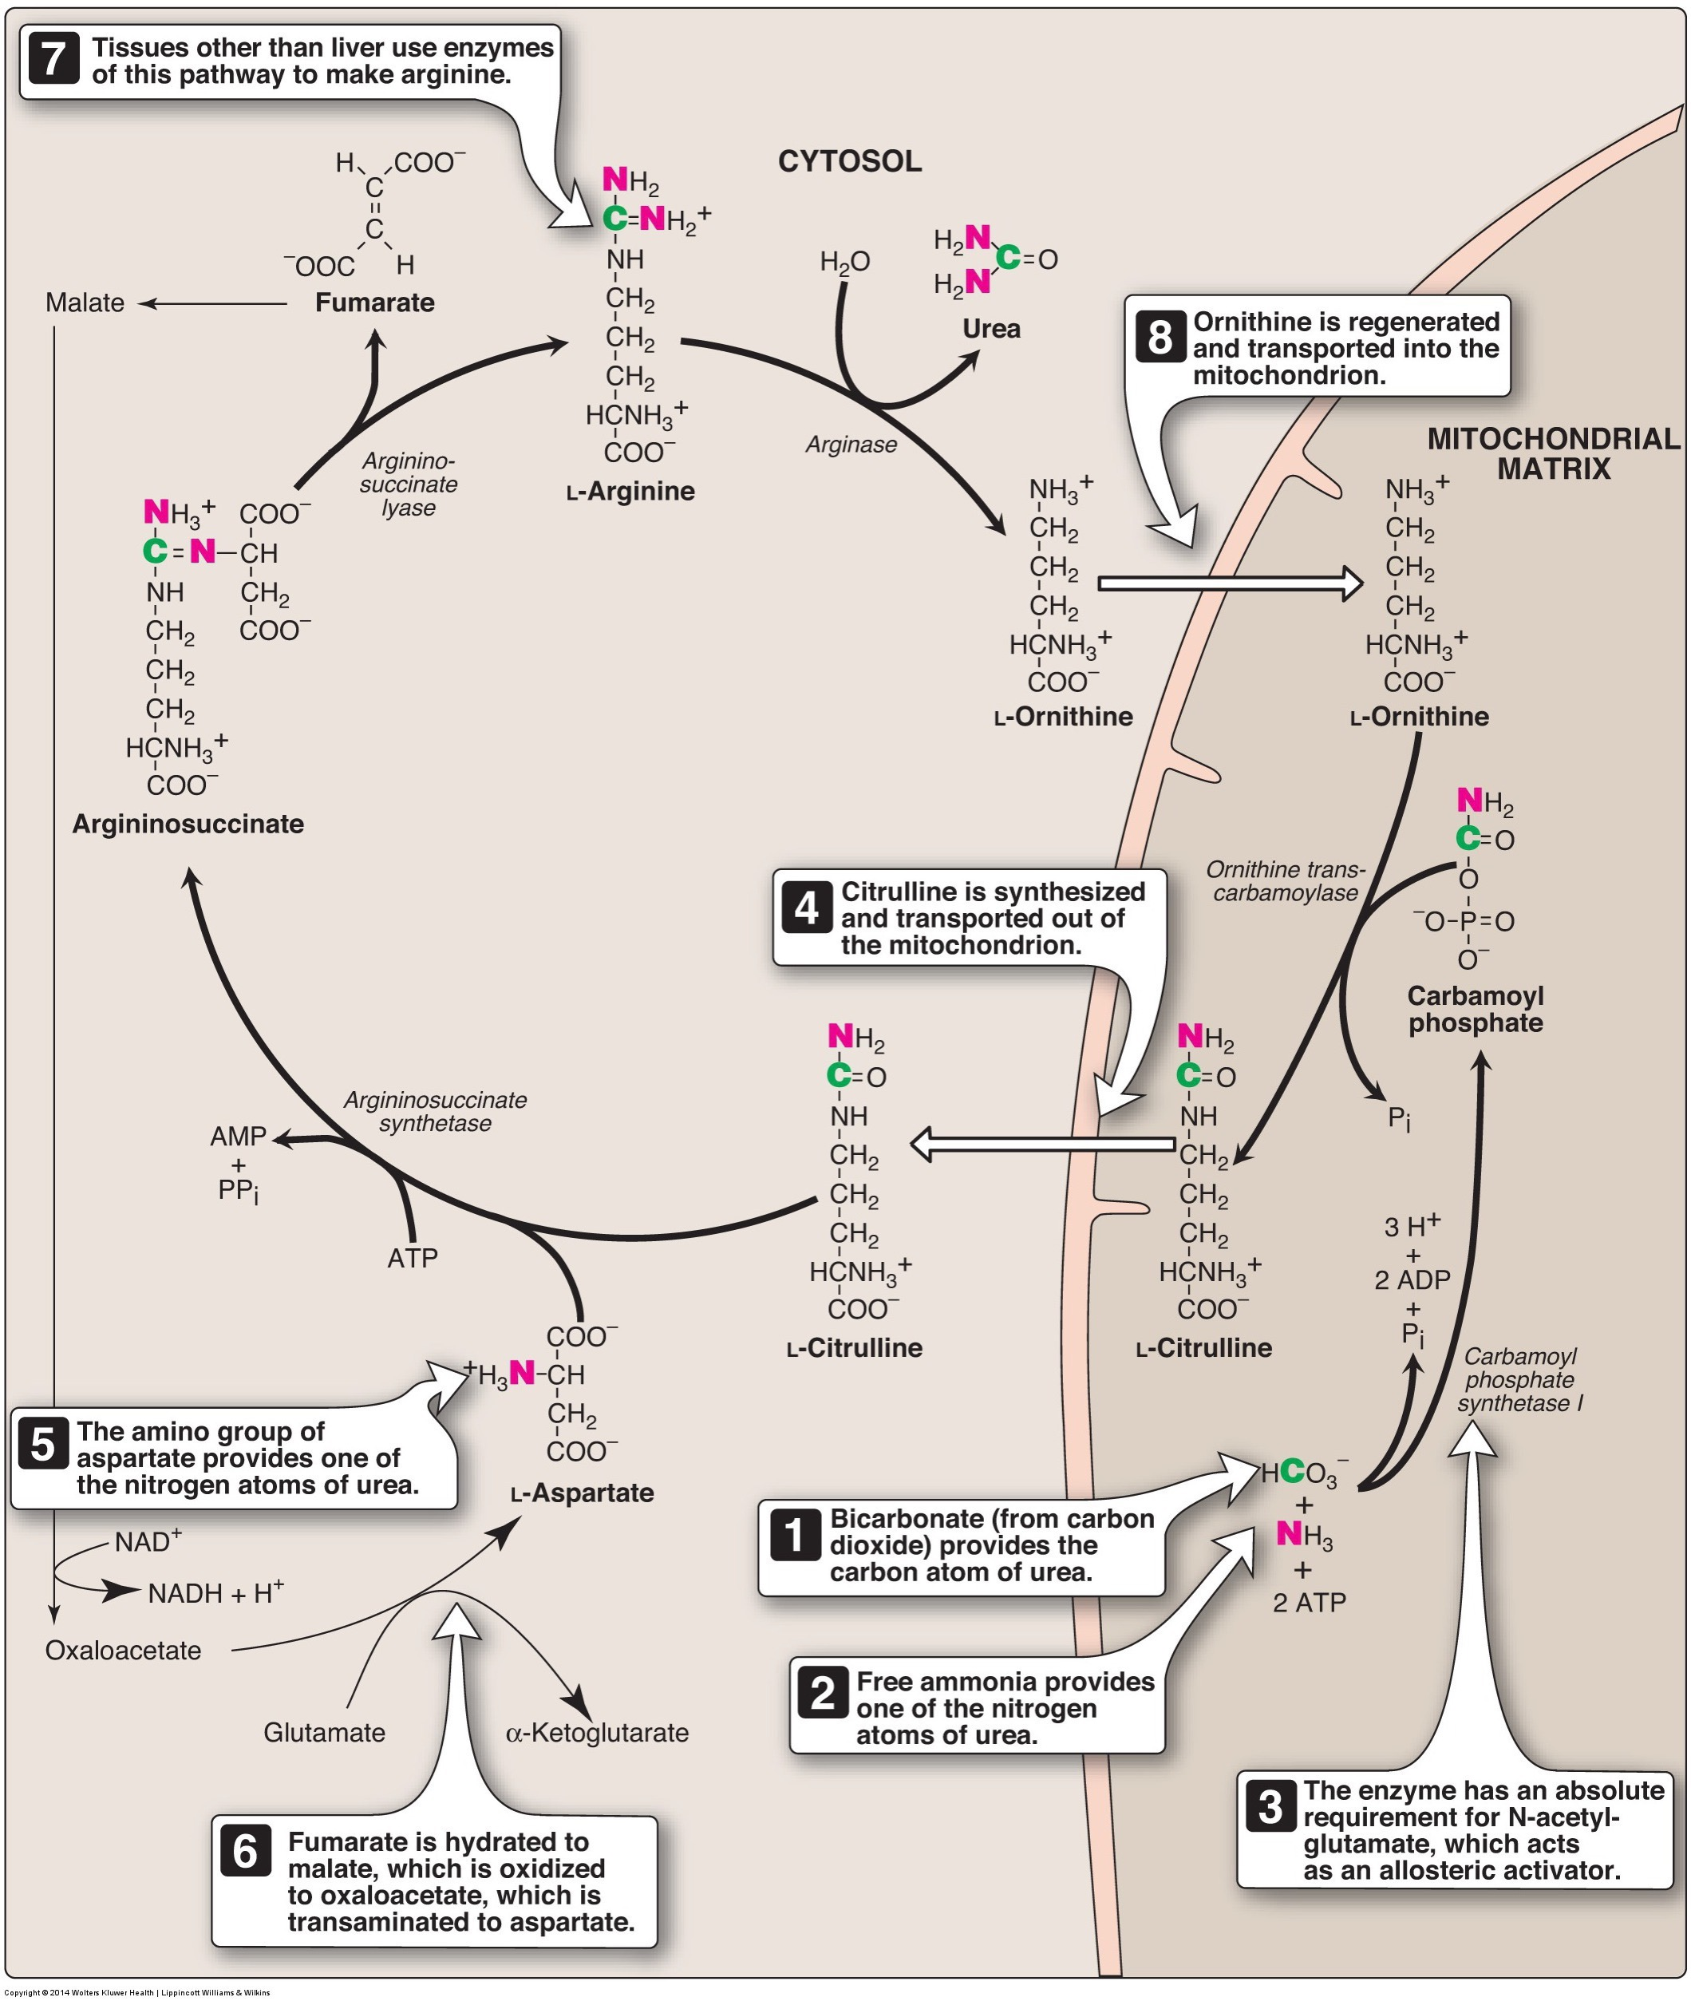
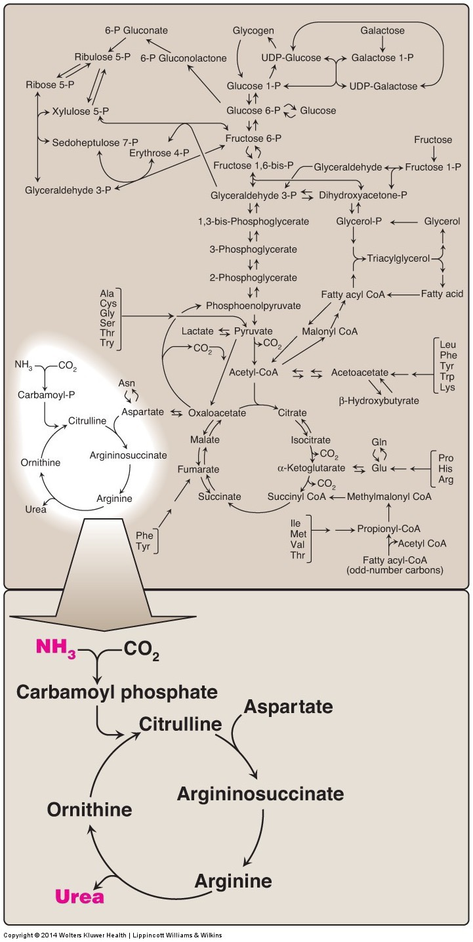
The Urea Cycle converts toxic ammonia into urea for excretion
Notes:
Uses 3 ATP to convert 1 ammonia to 1 urea

Slide 51
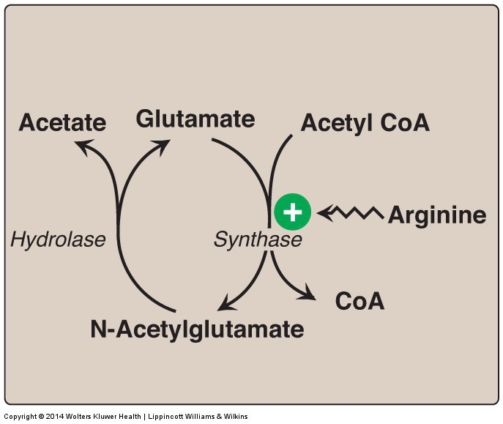
The Urea Cycle is Regulated by N-Acetylglutamate (NAG)
Activates carbamoylphosphate synthetase
NAG levels are increased with:
Glutamate
Acetyl-CoA
Arginine
Urea cycle enzymes are also increased by glucagon and glucocorticoids and decreased by insulin

Slide 52
Energy Demands of the Urea Cycle
Carbamoyl Phosphate Synthetase
2 ATP equivalents
Step 5 (Arginosuccinate Synthetase)
2 ATP equivalents

Slide 53
Degradation of the Carbon Skeletons

Slide 54
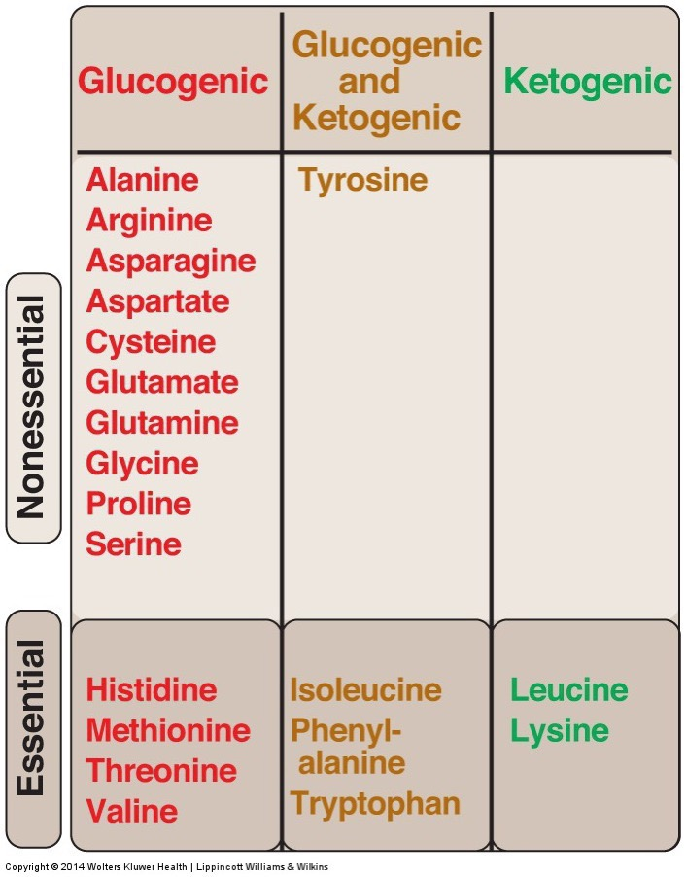
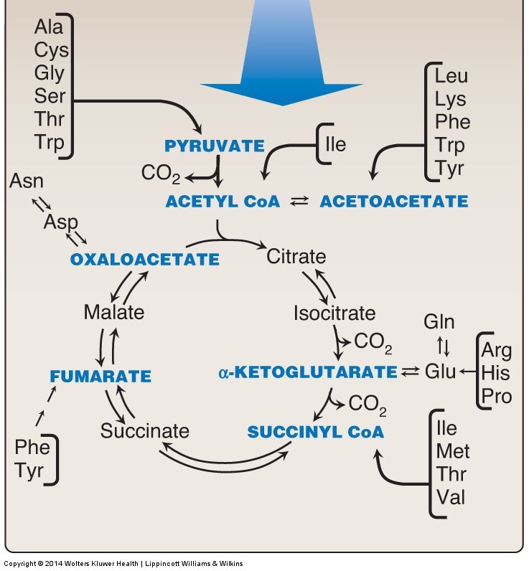
Glucogenic and Ketogenic

Slide 55
Amino Acids and Energy Production
For Glutamine oxidation what would be the equivalent ATP production?
How many NADH/FADH2/GTP produced by GLS/GDH and TCA?
What is ATP equivalence of those
How many ammonia disposed
What is ATP equivalence of those
Is this more or less than for Acetyl-CoA
aKG
Notes:
GLS – none
GDH - 1 NADH
aKG DH – 1 NADH
GTP
FAD
NADH
Total 10 ATP
3 NADH -> 7.5
1 FADH -> 1.5
1GTP -> 1
Process 2 Ammonia -> 8 ATP
Net 2 ATP

Slide 56
Learning Objectives
Describe the processes of proteolysis and autophagy which both lead to the degradation of proteins into amino acids
Understand which hormones, and which internal signals can promote protein degradation
Explain the biochemical basis which underlies whether amino acids are glucogenic or ketogenic
Understand the role that the Urea Cycle plays in metabolizing ammonia during amino acid catabolism

